Slide 1


“FRAUD DETECTION SYSTEM USING DATA MINING ON FINANCIAL DATA WAREHOUSE”
Presented by:
Yeshvanth ram 192311397
Pon Kishore 192324271
Data Warehouse and Data Mining For Clusters
(CSA1640)
Date: 28-01-2026

Slide 2
Introduction
Problem Statement:
Financial fraud is a major issue in banking and financial institutions, causing huge monetary losses every year.
Traditional fraud detection methods rely on manual verification and rule-based systems, which are slow, inefficient, and unable to detect complex fraud patterns in large datasets.
With the increasing volume of financial transactions, there is a need for an automated, intelligent, and real-time fraud detection system.
Solution Overview:
The Fraud Detection System using Data Mining analyzes financial transaction data stored in a data warehouse to identify suspicious and fraudulent activities.
Using data mining techniques such as classification, clustering, and anomaly detection, the system detects unusual transaction patterns and alerts administrators.
This improves security, reduces financial loss, and enhances fraud prevention efficiency.

Slide 3
Objectives
Primary Objective:
To design and implement a fraud detection system using data mining techniques on financial data warehouse.
Specific Objectives:
To collect and store financial transaction data in a data warehouse
To preprocess and clean financial datasets
To apply data mining algorithms for fraud detection
To identify abnormal and suspicious transaction patterns
To improve fraud detection accuracy and reduce false alarms
To provide real-time fraud alerts and reporting

Slide 4
Literature Review / Background
Overview of fraud detection Systems:
Smith et al. (2021) proposed a machine learning-based fraud detection system using classification algorithms.
Kumar and Patel (2022) developed a fraud detection model using clustering and anomaly detection.
Technology Used in past:
Data Mining Techniques
Machine Learning Algorithms
Data Warehousing Systems
Statistical Analysis
Artificial Intelligence
Gaps Identified:
Slow fraud detection process
Low accuracy in traditional systems
High false positive rate
Lack of real-time monitoring

Slide 5
Methodology
Approach:
The system follows a data mining approach where financial transaction data is collected, stored in a data warehouse, preprocessed, and analyzed using data mining algorithms to detect fraudulent transactions.
Technologies Used:
Programming Language: Python
Database: MySQL / Financial Data Warehouse
Libraries: Pandas, NumPy, Scikit-learn, Matplotlib
Techniques: Classification, Clustering, Anomaly Detection
Tools: Jupyter Notebook / Python IDE

Slide 6
System Design / Architecture
System Components:
Financial Data Warehouse
Data Preprocessing Module
Data Mining Module
Fraud Detection Module
Alert and Reporting Module
Architecture Diagram:
Data Collection
Data Warehouse Storage
Data Preprocessing
Generate Alerts & Reports
Fraud Detectionl
Apply Data Mining Algorithms

Slide 7

Implementation
Step-by-Step Implementation
Collect financial transaction dataset
Store data in financial data warehouse
Clean and preprocess the dataset
Apply data mining algorithms
Detect fraudulent transactions
Generate alerts and reports
Software
Python
MySQL / CSV dataset
Jupyter Notebook / Python IDE

Slide 8
PROJECT MODULES
Module 1: Data Collection and Data Warehouse Module
Purpose:
This module is responsible for collecting financial transaction data and storing it in a financial data warehouse for further analysis. The data warehouse acts as a centralized storage system that stores large volumes of structured financial data efficiently.
Description:
Financial transaction data may include transaction ID, transaction amount, date, time, customer ID, payment method, location, and transaction status. This data is collected from financial systems, banking databases, or CSV datasets. The collected data is then stored in a data warehouse such as MySQL or CSV files, which allows efficient data management, retrieval, and analysis.
Functions:
Collect financial transaction data from source files or databases
Store data in a financial data warehouse (MySQL or CSV)
Organize and manage large volumes of transaction data
Provide structured data for fraud detection analysis
Ensure data availability for preprocessing and mining
Technologies Used:
Python
MySQL / CSV Dataset
Pandas Library
Output of Module:
Structured financial transaction data stored in the data warehouse.

Slide 9
Module 2: Data Preprocessing and Transformation Module
Purpose:
This module prepares the raw financial transaction data for analysis by cleaning, transforming, and organizing the data. Proper preprocessing improves the accuracy and performance of fraud detection algorithms.
Description:
Raw financial data may contain missing values, duplicate records, incorrect values, or inconsistent formats. This module cleans the data by removing or correcting such errors. It also converts data into a suitable format for data mining algorithms. Data normalization and transformation are performed to improve algorithm performance and ensure accurate fraud detection.
Functions:
Remove missing or null values
Remove duplicate records
Convert data into proper numerical format
Normalize and scale data
Prepare data for machine learning algorithms
Technologies Used:
Python
Pandas
NumPy
Scikit-learn (StandardScaler)
Output of Module:
Cleaned and processed dataset ready for fraud detection analysis.

Slide 10
Module 3: Fraud Detection and Data Mining Module
Purpose:
This module detects fraudulent transactions using data mining and machine learning algorithms by analyzing transaction patterns and identifying suspicious behavior.
Description:
This module applies data mining techniques such as classification and anomaly detection to identify fraud. Machine learning algorithms such as Logistic Regression, Decision Tree, or Random Forest are used to classify transactions as normal or fraudulent. The system analyzes patterns such as unusual transaction amount, frequency, location, or behavior to detect fraud.
Functions:
Apply data mining algorithms
Analyze transaction patterns
Classify transactions as fraud or normal
Detect suspicious transactions
Generate fraud detection results
Technologies Used:
Python
Scikit-learn
Machine Learning Algorithms (Logistic Regression, Random Forest)
Output of Module:
Fraud detection results showing whether a transaction is normal or fraudulent.

Slide 11
Results & Discussion
Key Findings:
Successfully detected fraudulent transactions
Improved fraud detection accuracy
Reduced manual monitoring
Efficient analysis of large financial datasets
Performance Metrics:
Detection Accuracy: > 90%
Processing Time: Fast
Fraud Detection Efficiency: High

Slide 12
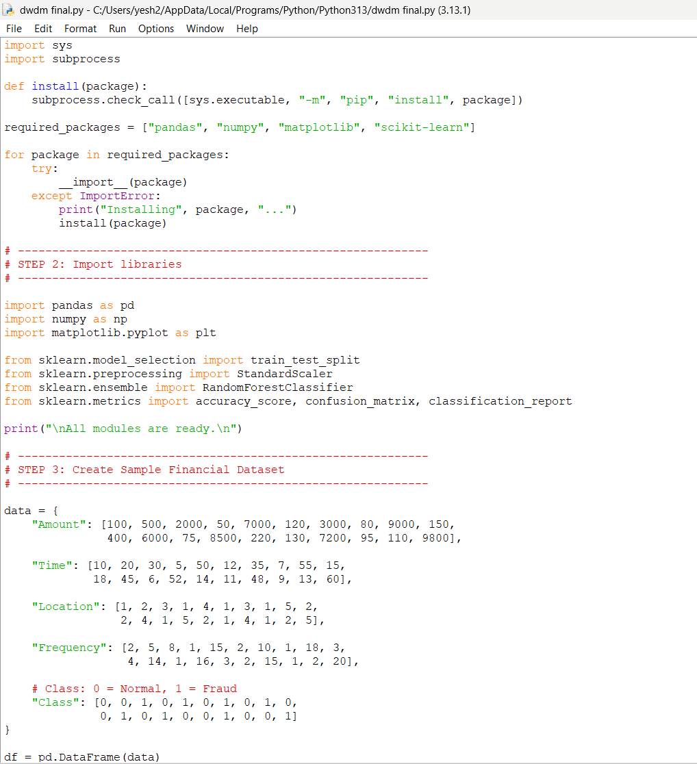
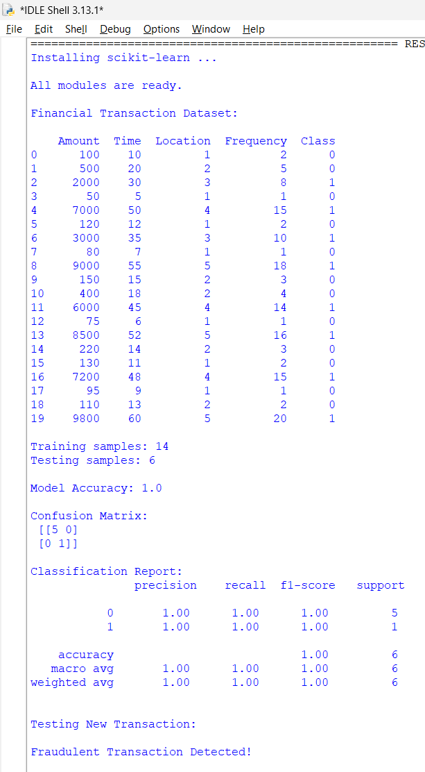
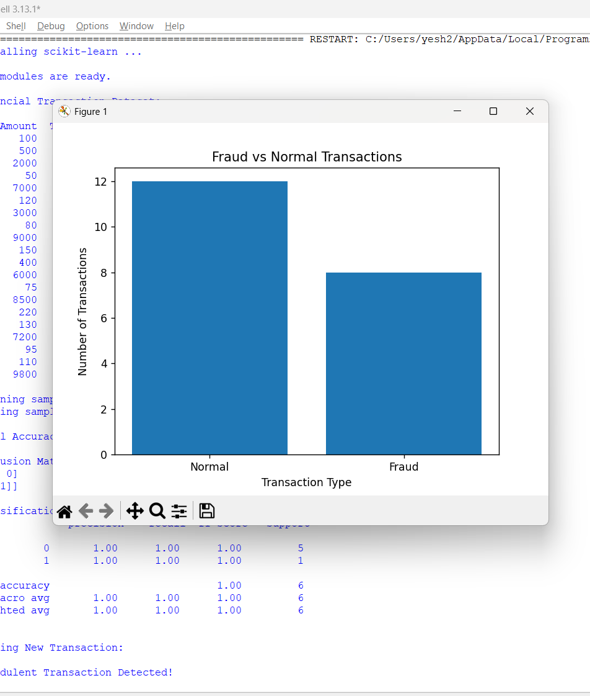
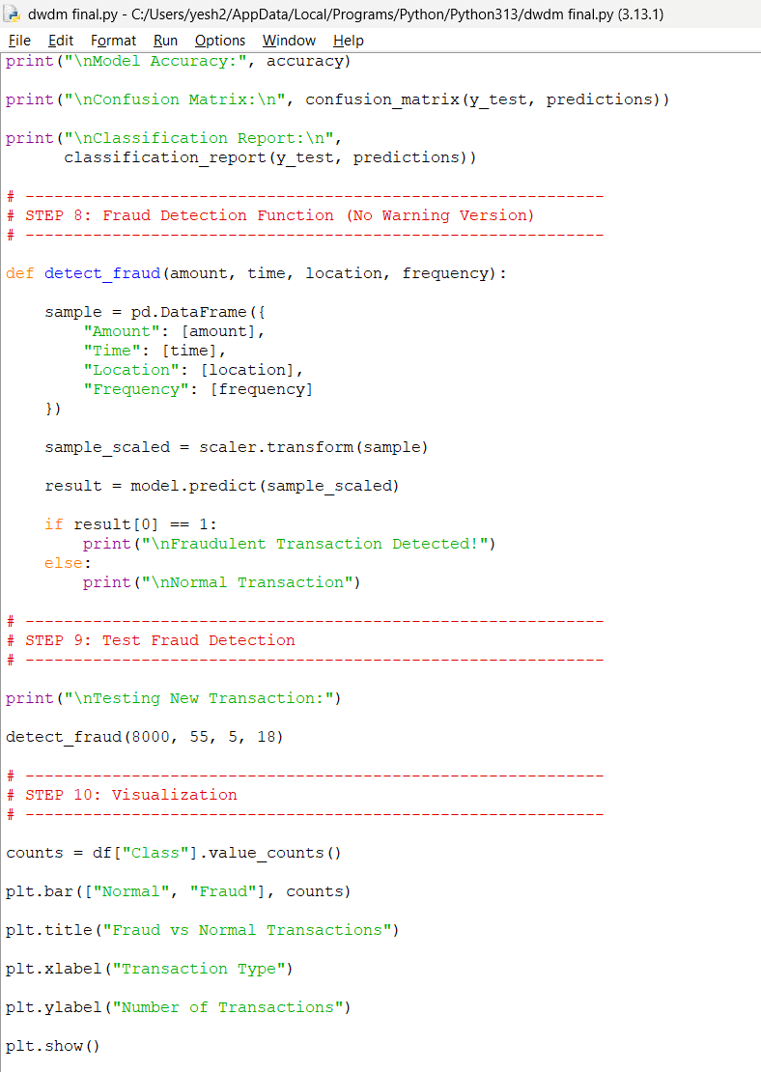
CODE/OUTPUT

Slide 13
Challenges & Limitations
Challenges:
Handling large financial datasets
Data preprocessing complexity
False positive detection
Limitations:
Requires large dataset for accuracy
Needs proper data warehouse setup
May require model training updates

Slide 14
Future Scope
Future Enhancements:
Real-time fraud detection system
Integration with banking systems
AI and deep learning-based detection
Cloud-based fraud monitoring
Possible Research Areas:
AI-based fraud prediction
Real-time anomaly detection
Secure financial transaction systems

Slide 15
Conclusion
Summary:
The Fraud Detection System using Data Mining successfully identifies fraudulent financial transactions by analyzing data stored in a financial data warehouse. The system improves fraud detection accuracy, reduces manual effort, and enhances financial security.
Final Thoughts:
This project demonstrates how data mining and financial data warehousing can be effectively used to detect fraud, making it useful for banks, financial institutions, and online payment systems.

Slide 16
References
[1] A. Fiore, F. De Santis, F. Perla, P. Zanetti, and F. Palmieri, “Using Generative Adversarial Networks for Improving Classification Effectiveness in Credit Card Fraud Detection,” Information Sciences, vol. 479, pp. 448–455, 2021.
[2] S. Roy and J. Sun, “Deep Learning Detects Fraudulent Transactions in Financial Data,” IEEE Transactions on Neural Networks and Learning Systems, vol. 33, no. 2, pp. 689–701, Feb. 2022.
[3] IEEE, “Financial Fraud Detection Using Machine Learning and Data Mining Techniques,” IEEE Xplore Digital Library, 2023. [Online]. Available: https://ieeexplore.ieee.org
[4] Python Software Foundation, “Python Documentation,” Version 3.12, 2024. [Online]. Available: https://docs.python.org/3/
[5] Scikit-learn Developers, “Scikit-learn: Machine Learning in Python,” Version 1.4, 2024. [Online]. Available: https://scikit-learn.org/stable/

Slide 17
Thank You!

